Slide 1
Team 1
Publishing Plan Review
Project 2, Final Draft

Slide 2
Purpose
The path of publishing original work can appear daunting, so it is essential to create a publishing plan to clarify details such as budget, materials, and various other important decisions.
For this presentation, Team 1 presents an overview of the feedback given on our final publishing plans for the upcoming semester design project. The chosen themes for each project are as follows:
Project 1: Creative Writing Booklet
Project 2: Animal Booklet
Project 3: Literary Zine

Slide 3
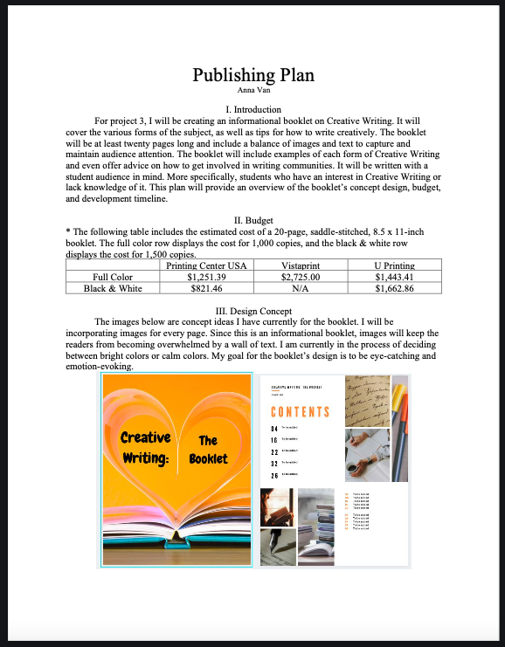
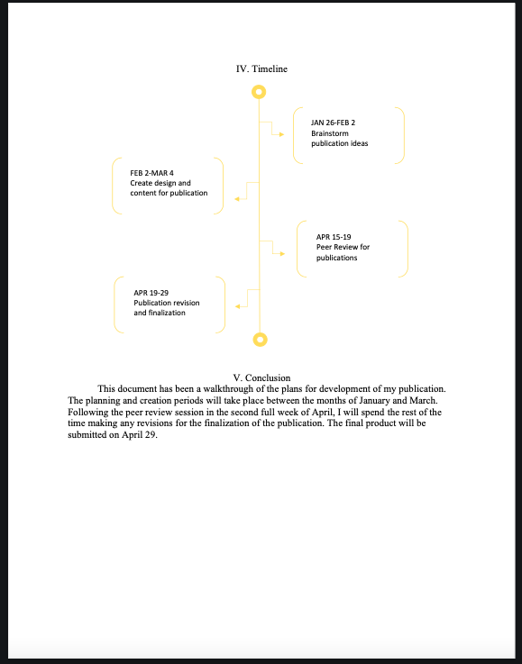
Plan 1: Creative Booklet

Slide 4
Plan 1: Strengths and Weaknesses
Strengths | Weaknesses
Engaging Visuals | Design concept
Consistent Alignment | Brevity of Text
Detailed Explanations | Narrow Conclusion
Timeline Design | Budget Design
Clarity of Text | Font Contrast

Slide 5
Plan 1: 10 Suggestions for Improvement
Add more visuals.
Expand design concept.
Expand timeline.
Include what software(s) helped you.
Include in-progress screenshots of work.
What fonts/typeface will be used?
Include color combinations/options.
Add more white space between sections.
Include a title page.
Expand conclusion to include an overview of your goals, as well as timeline specifics.
The “Budget” could flow better if the asterisk (*) section is underneath the table and if the number of copies is specified within the table (i.e. 1,500 B&W copies).

Slide 6
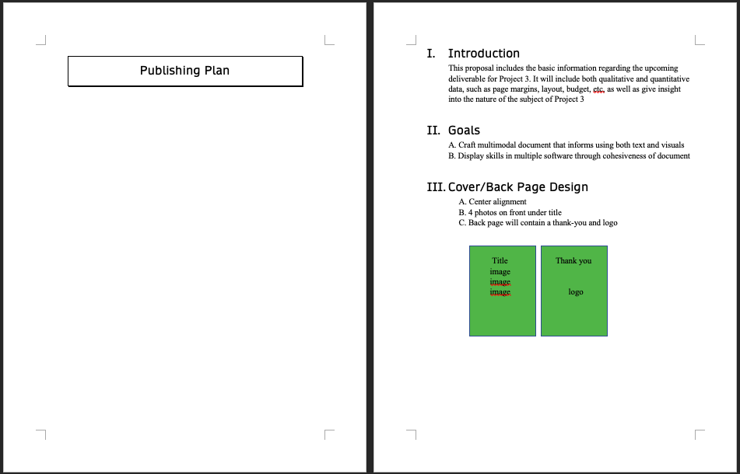
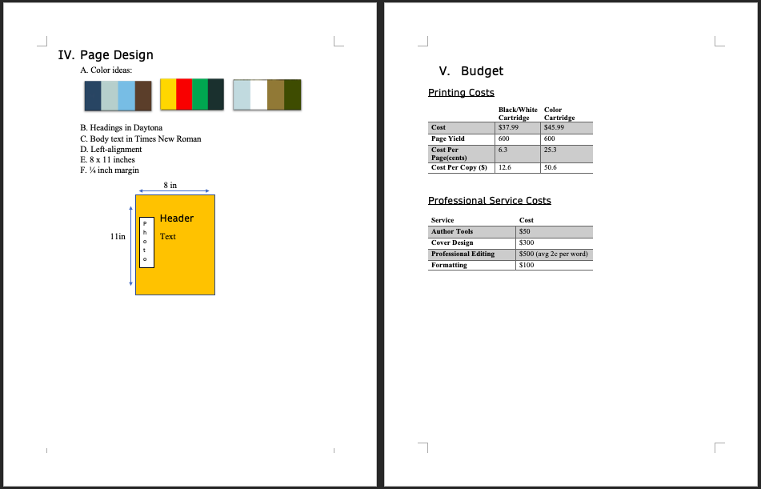
Plan 2: Animal Booklet

Slide 7
Plan 2: Strengths and Weaknesses
Strengths | Weaknesses
Detailed Page Specifications | Font Contrast
Layout Visuals | Inconsistent Alignment
Budget Design | Budget Totals
Color Palettes | Vague Goals
Organized Sections & Headings | Lack of Sources for Costs

Slide 8
Plan 2: Suggestions for Improvement
Include name of designer on title page.
Specify what you’re designing in the introduction.
What are the genre conventions of the project you want to design?
Add more white space in between sections.
Choose a consistent alignment style throughout the document, including for images and tables.
Diversify fonts between the headings and body text for better contrast.
What specific softwares are you using (specified under “Goals”)?
What are the total printing costs?
What are the names of the printing and professional services used?
Add a timeline to show the development and progress.

Slide 9
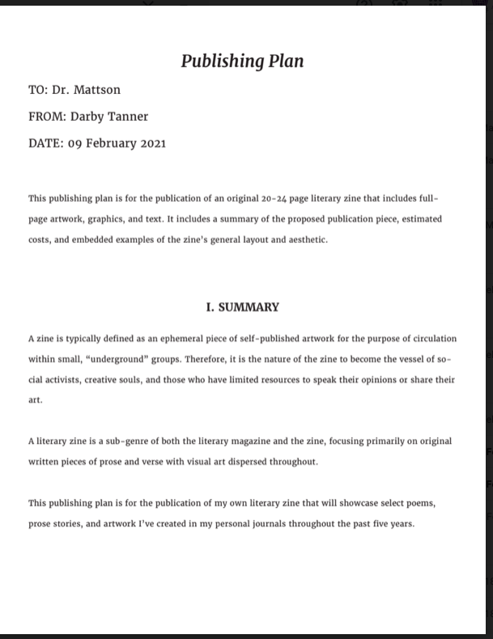
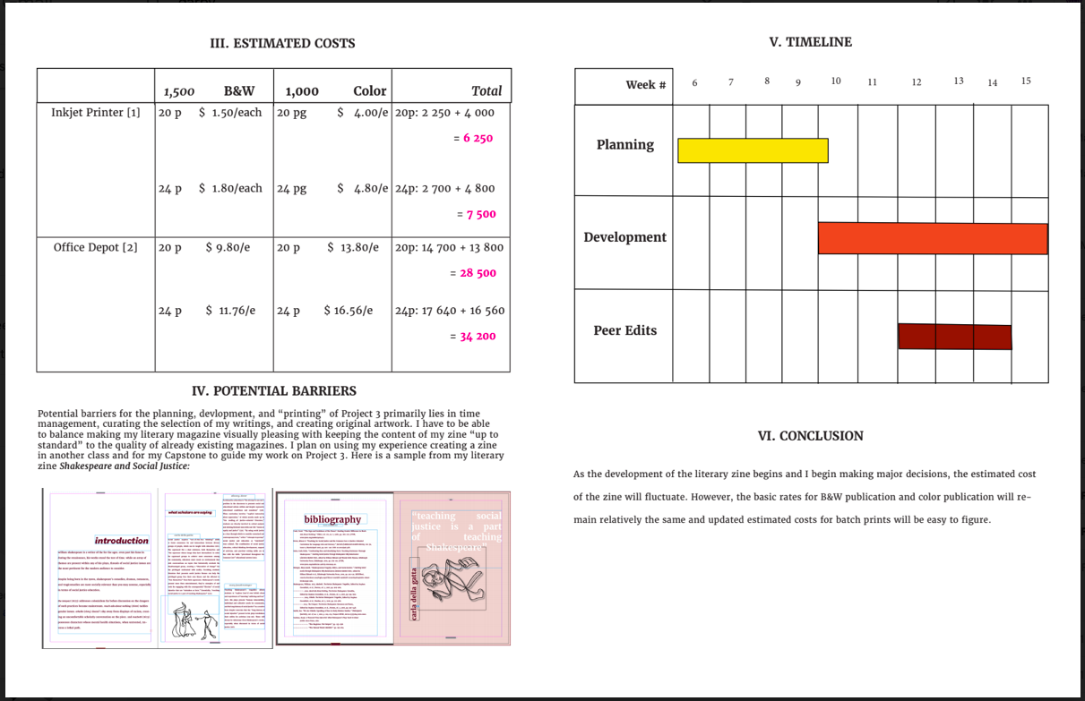
Plan 3: Literary Zine

Slide 10
Plan 3: Strengths and Weaknesses
Strengths | Weaknesses
Screenshots | Text-heavy
Software Variety | Cramped Spacing
Explanations/Reasoning | Page Specifications
Detailed Table for Cost Projection | No Individual Section for Design Sample
Organized Sections & Headings | Small-Sized Sample Images

Slide 11
Plan 3: Suggestions for Improvement
Decrease text.
Include more visuals.
Would like to see in-progress screenshots of work.
Include color scheme/options.
What typeface will you use?
What will the page dimensions be?
The timeline could be smaller and the program screenshots could be larger.
Add more color to the timeline and costs table.
Separate sample images into a new section introducing the design concept.
Swap “20p” and “24p” with “20 pg” and “24 pg” for more clarity, as done in the second table cell in the Inkjet Printer row.

Slide 12
Conclusion
In summary, each publishing plan has its fair share of strengths and weaknesses.
Project 1 succeeded in consistent alignment and in its timeline design but fell short when it came to brevity of diction and the budget’s design.
Project 2 had amazing visuals and detailed design concept but could use additional clarity about its publication and contrast between its heading and body fonts.
Project 3 implemented clear explanations of its publication and a satisfactory amount of visuals, but failed to condense its text and contained inconsistent spacing between its sections.

